Slide 1
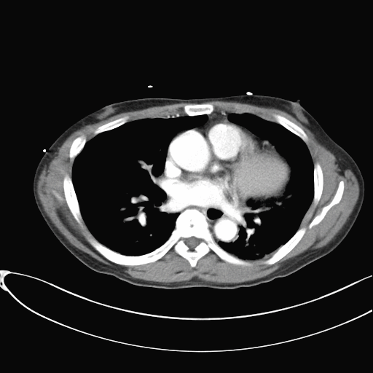
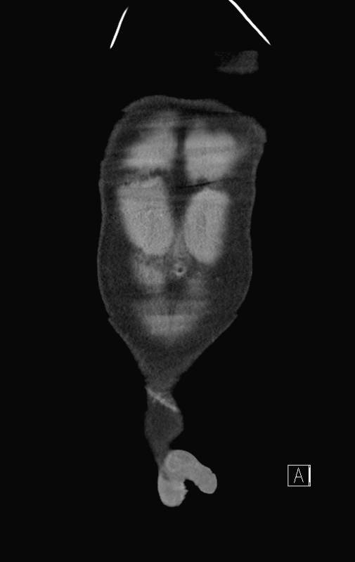
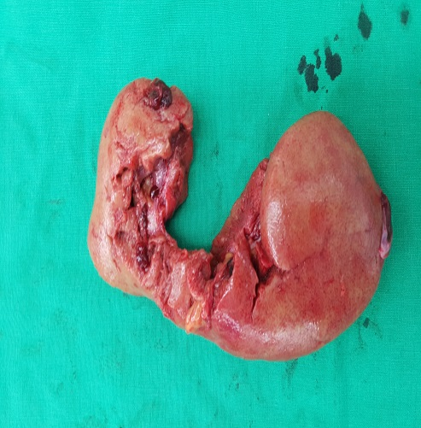
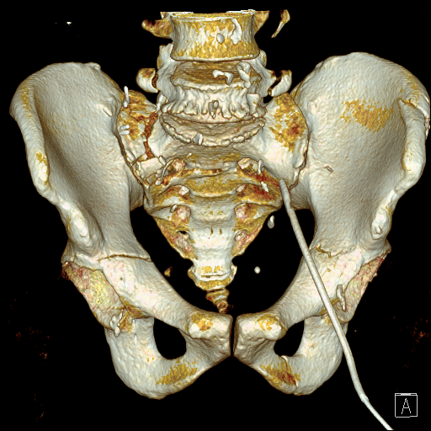
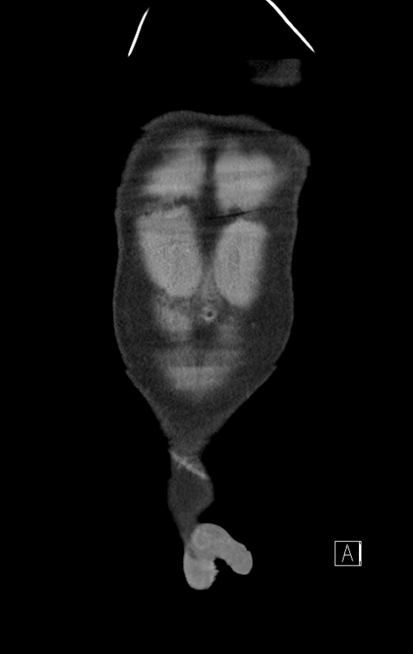

Title
Gil Dong, Honge
Department of Pediatrics, Asan Medical Center Children’s Hospital, University of Ulsan College of Medicine, Seoul, Korea
47-year old male visited trauma center directly from the scene.
He was struck on the lower abdomen by heavy object in the construction site.
He was alert and his initial vital signs were as below:
    Blood pressure 90/60mmHg, Heart rate 55/min, Respiratory rate 18/min, Body temperature 36.5℃
He had transplanted a kidney due to end-stage renal disease a year ago.
After the CT scan, he was brought to the operation room for the laparotomy.
There were a large amount of blood in the abdomen, both transplanted renal artery and vein transection and the transplanted ureteral transection.
There was no more bleeding after nephrectomy.
He took the continuous renal replacement therapy(CRRT) immediately after the laparotomy.
He underwent pelvic fracture surgery on POD #5 and was discharged home without complications.
Figure 1. Contrast enhanced CT scan
Figure 2. Specimen of injured kidney
Figure 3. 3D hip CT scan

